Slide 1
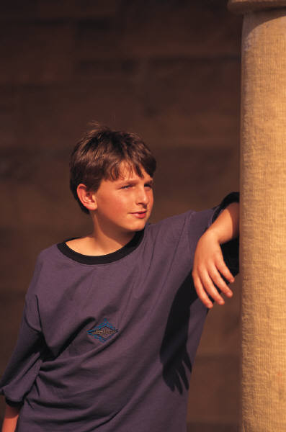



MIDDLE SCHOOL 101
Everything you want to know about parenting a middle school student

Slide 2
BEHAVIOR
Know that middle schoolers will lose their mind!
  Tell yourself, “They aren’t angry, they aren’t an alien, they aren’t mental. They are just 13!”
Risk-takers by nature

Slide 3

BEHAVIOR
Middle school students will try new things.
Mixture of being a kid and being an adult.
  Keep in mind that they aren’t a child anymore, but they aren’t an adult, either. Treating them like either one will lead to disaster.
They want boundaries, but will test them!!!
Notes:
Change wifi password daily – “To get today’s wifi password: 1. empty trash 2. clean room 3. do homework”

Slide 4


SOCIAL LIVES
A middle schooler’s social life is the most important thing to them.
Help them learn how to navigate “social drama”. Conflict is a natural part of life
Monitor online/cell phone activities!!!!!!!
  Have your child’s password and check their
  activity often.
Notes:
Cell phone tracking websites: spectersoft.org; safe eyes; getnetwise; textblocker – disables texting while in motion
Know the stats – know the world they live in: 6-9 years old: 77% - cell phones; 58% - video games; 52%-ride bikes; 20%-swim

Slide 5

DISCIPLINE
4 Cs and an L:
  Be CLEAR.
  Be CONSISTENT.
  Be CALM.
  Have CONSEQUENCES.
  LOVE!

Slide 6


Be CLEAR!
Have specific limits/boundaries.
  Never let them get the idea that they are the boss!
  Be strong. This is not the time in their lives to relax the rules.
Be as detailed as possible with the expectations as well as the consequences. Written contracts are useful.
Notes:
Parent in community – doing things at the same time with a group of other parents

Slide 7
Be CONSISTENT!
Choose your battles!
Be on the same page with all those that
care for your child.
If you give an inch, they will take a mile!
  Remember, they are always testing the boundaries. Think long and hard before letting them move so much as an inch.
Notes:
Behavior contracts – takes out the emotional part

Slide 8
Be CALM!
Discipline without drama.
  Dispassionate cop example
Do not argue with a middle schooler!
Continue saying the same thing until they comply.
Notes:
Respect – teach it in/out of the home
“try again” when they don’t do it right
Model it; model gratitude
Require it

Slide 9
Have CONSEQUENCES!
The consequence should fit the crime.
Follow through!
  Don’t shield them from the consequences of their bad behavior.
  If they are getting in trouble at school all the time, it probably is their fault.
Notes:
Laps around the house

Slide 10


LOVE!!!!
Don’t forget to just LOVE your middle school student!
  Every now and then go into their room, sit down, and just visit!
Spend time together as a family…
  Dinner
  Movies
  Shopping
  Vacations
Notes:
They may push you away, tell you that you don't understand or that it is none of your business. Encourage them to share anyway. Remember to LISTEN not TALK.
Forgiveness – it is a decision – don’t wait until they deserve it
Don’t give empty compliments.
Make home safe.
Enjoy them – help them to enjoy themselves.
Serve others – volunteering increases self-esteem.
Parent out of LOVE not out of FEAR.

Slide 11

Communication
Use the “less is more” approach – wait and listen; be an observer; ask open ended questions
Be straightforward when addressing uncomfortable issues.

Slide 12
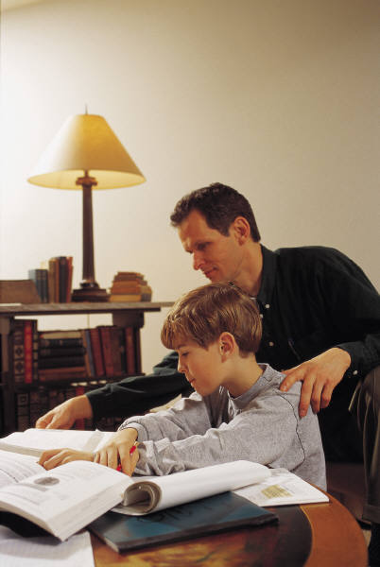
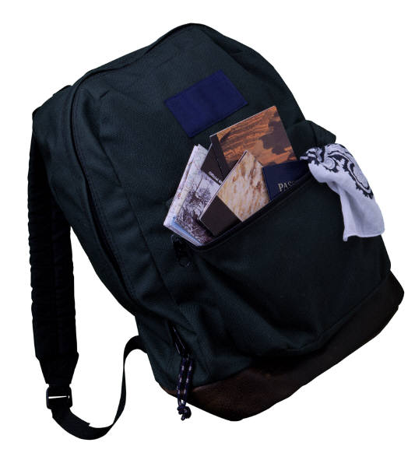
ACADEMICS
Organization (needs to fit their style…not yours!)
  Locker
  Backpack
  Binder
  Study time
  Study place
  If their grades slip, make them study in front of you, offer assistance and show interest in what they are learning. Their grades will improve dramatically!

Slide 13
ACADEMICS
Be involved! Insist that they let you know where they are at all times!
  “Presence deters problems”
  They will still need your assistance!
  Allow more freedom/responsibility…in small doses! (still check planner, PowerSchool, etc.) https://powerschool.cmcss.net/public/
    Online access to weekly grades/report cards
    Communicate with teachers
    Review attendance

Slide 14
ACADEMICS
Check the teacher’s websites frequently!
Ask questions – to your child and to your child’s teachers.
  Be a part of their world.
  Let them know you are aware of their lives.

Slide 15
Extracurricular Activities
After school program (academic as well as interest based)
Sports
  Parks and Rec; MCSA; karate; gymnastics; dance
Community resources for students:
  Beyond the Books
  Advantage Learning Center
  Sylvan Learning Center

Slide 16
RESOURCES
http://www.education.com/grade/middle-school/
http://www.schoolfamily.com/school-family-articles/article/801-10-tips-for-middle-school-parents
www.pbs.org/parents/itsmylife/resources/middleschool.html /

Slide 17
RESOURCES (cont.)
http://www.middleweb.com/mw/resources/MWRpublic.html
http://www.pbs.org/parents/itsmylife/resources/middleschool.html
http://parentingteens.about.com/

Slide 18
RESOURCES
Military affiliated – MFLC
Centerstone Counselor (for TennCare recipients)
Community Psychological Agencies
Teachers
Homework Helpline: 298-6636; 888-868-5777 (4-8pm M-Th)
Counselors
  Ms. Rollins – 8th grade, 8th grade Mighty Eagles and 7th grade Falcons.
  Ms. Smith – 6th grade, 7th grade Mighty Eagles and 7th grade American Eagles

Slide 19
FINAL THOUGHTS
Spend as much time with them as you can but allow them autonomy to explore their curiosity!
Do not let one disrespectful comment slide. EVER!
Demand respect. At all times.
They will want you to be their friend. But what they really need is a parent!
Accept the fact that they will be in a bad mood for the next three years! BUT...know that you can help to alleviate some of their frustration through active listening, positive reinforcement of desired behaviors and firm consequences when necessary.

